Slide 1
Dependent and Independent
(依賴的、不獨立的)
(獨立的、自主的)

Slide 2
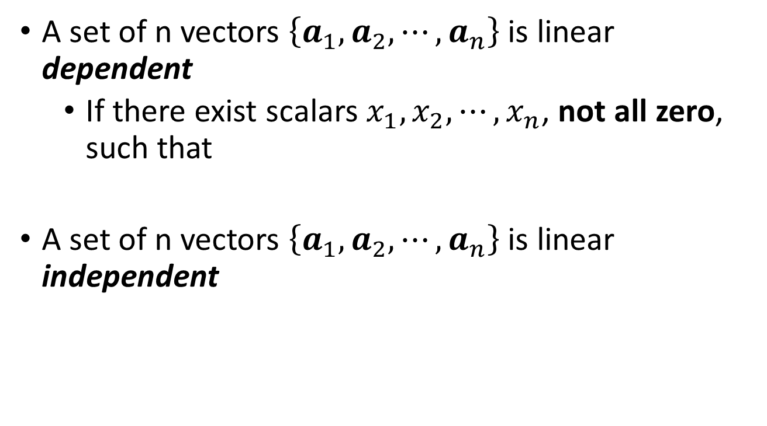
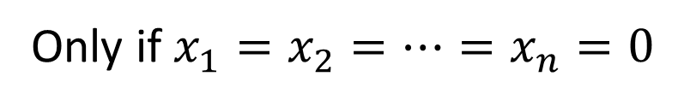
Definition
A set of n vectors $\left\{a_{1},a_{2},⋯,a_{n}\right\}$ is linear dependent
If there exist scalars $x_{1},x_{2},⋯,x_{n}$, not all zero, such that
A set of n vectors $\left\{a_{1},a_{2},⋯,a_{n}\right\}$ is linear independent
Find one
Obtain many
$$x_{1}a_{1}+x_{2}a_{2}+⋯+x_{n}a_{n}=0$$
2
2
2
$$x_{1}a_{1}+x_{2}a_{2}+⋯+x_{n}a_{n}=0$$
Only if $x_{1}=x_{2}=⋯=x_{n}=0$
unique
Notes:
How about the vector with only one element?

Slide 3
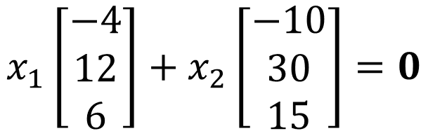
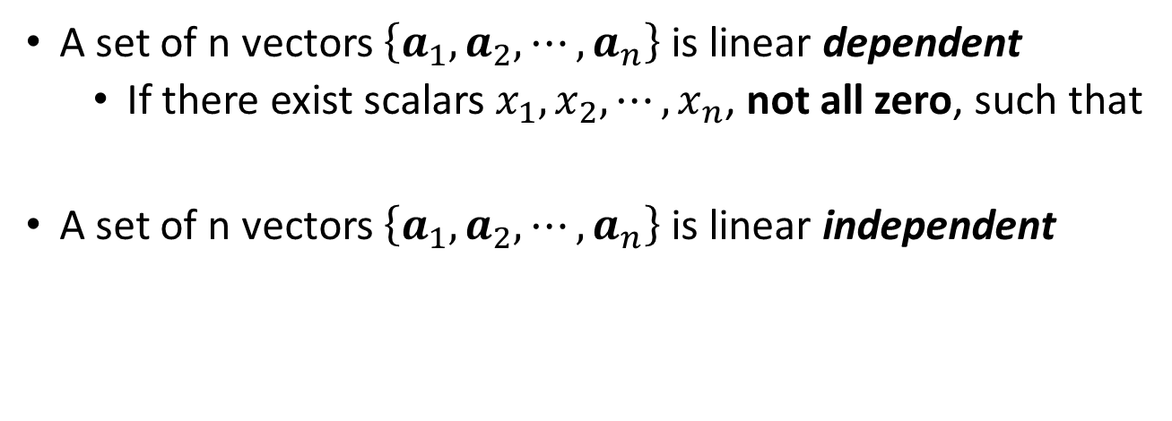
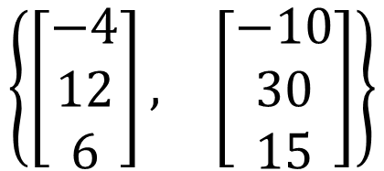
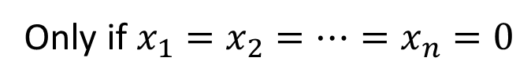


A set of n vectors $\left\{a_{1},a_{2},⋯,a_{n}\right\}$ is linear dependent
If there exist scalars $x_{1},x_{2},⋯,x_{n}$, not all zero, such that
A set of n vectors $\left\{a_{1},a_{2},⋯,a_{n}\right\}$ is linear independent
$$x_{1}a_{1}+x_{2}a_{2}+⋯+x_{n}a_{n}=0$$
$$x_{1}a_{1}+x_{2}a_{2}+⋯+x_{n}a_{n}=0$$
Only if $x_{1}=x_{2}=⋯=x_{n}=0$
$$\left\{\begin{matrix}\left[\begin{matrix}−4 \\ 12 \\ 6\end{matrix}\right], & \left[\begin{matrix}−10 \\ 30 \\ 15\end{matrix}\right]\end{matrix}\right\}$$
Dependent or Independent?
dependent
$$x_{1}\left[\begin{matrix}−4 \\ 12 \\ 6\end{matrix}\right]+x_{2}\left[\begin{matrix}−10 \\ 30 \\ 15\end{matrix}\right]=0$$
5
-2
Notes:
How about the vector with only one element?

Slide 4
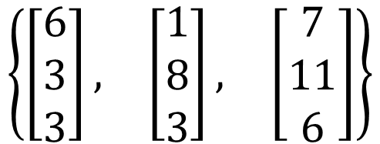
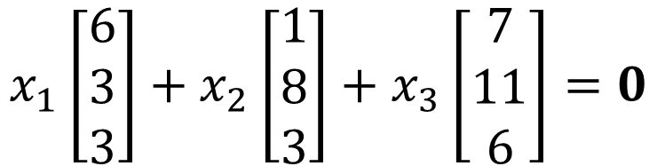
A set of n vectors $\left\{a_{1},a_{2},⋯,a_{n}\right\}$ is linear dependent
If there exist scalars $x_{1},x_{2},⋯,x_{n}$, not all zero, such that
A set of n vectors $\left\{a_{1},a_{2},⋯,a_{n}\right\}$ is linear independent
$$x_{1}a_{1}+x_{2}a_{2}+⋯+x_{n}a_{n}=0$$
$$x_{1}a_{1}+x_{2}a_{2}+⋯+x_{n}a_{n}=0$$
Only if $x_{1}=x_{2}=⋯=x_{n}=0$
$$\left\{\begin{matrix}\left[\begin{matrix}6 \\ 3 \\ 3\end{matrix}\right], & \left[\begin{matrix}1 \\ 8 \\ 3\end{matrix}\right], & \left[\begin{matrix}7 \\ 11 \\ 6\end{matrix}\right]\end{matrix}\right\}$$
Dependent or Independent?
dependent
$$x_{1}\left[\begin{matrix}6 \\ 3 \\ 3\end{matrix}\right]+x_{2}\left[\begin{matrix}1 \\ 8 \\ 3\end{matrix}\right]+x_{3}\left[\begin{matrix}7 \\ 11 \\ 6\end{matrix}\right]=0$$
1
1
-1
Notes:
How about the vector with only one element?

Slide 5
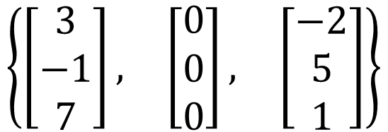
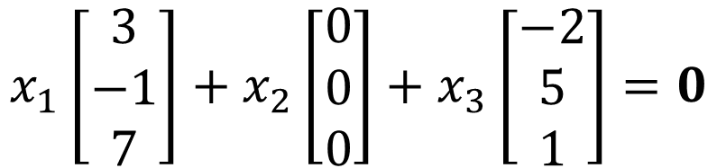
A set of n vectors $\left\{a_{1},a_{2},⋯,a_{n}\right\}$ is linear dependent
If there exist scalars $x_{1},x_{2},⋯,x_{n}$, not all zero, such that
A set of n vectors $\left\{a_{1},a_{2},⋯,a_{n}\right\}$ is linear independent
$$x_{1}a_{1}+x_{2}a_{2}+⋯+x_{n}a_{n}=0$$
$$x_{1}a_{1}+x_{2}a_{2}+⋯+x_{n}a_{n}=0$$
Only if $x_{1}=x_{2}=⋯=x_{n}=0$
$$\left\{\begin{matrix}\left[\begin{matrix}3 \\ −1 \\ 7\end{matrix}\right], & \left[\begin{matrix}0 \\ 0 \\ 0\end{matrix}\right], & \left[\begin{matrix}−2 \\ 5 \\ 1\end{matrix}\right]\end{matrix}\right\}$$
Dependent or Independent?
dependent
$$x_{1}\left[\begin{matrix}3 \\ −1 \\ 7\end{matrix}\right]+x_{2}\left[\begin{matrix}0 \\ 0 \\ 0\end{matrix}\right]+x_{3}\left[\begin{matrix}−2 \\ 5 \\ 1\end{matrix}\right]=0$$
0
Any
0
Any set contains zero vector would be linear dependent
Notes:
How about the vector with only one element?

Slide 6
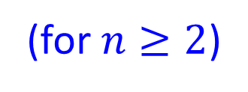
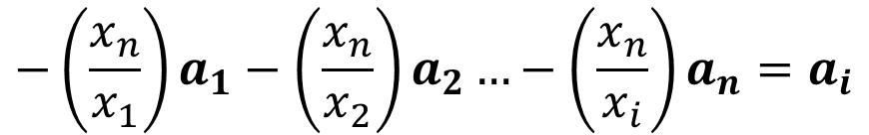


Linear Dependent
(for $n≥2$)
Given a vector set, {a₁, a₂, …, a_{n}}, there exists scalars x₁, x₂, …, x_{n}, that are not all zero, such that x₁a₁ + x₂a₂ + ☹ + x_{n}a_{n} = 0.
$$x_{1}a_{1}+x_{2}a_{2}…+x_{i}a_{i}+…+x_{n}a_{n}=0$$
永遠可以找到某一項有非 0係數
$$x_{i}≠0$$
$$x_{1}a_{1}+x_{2}a_{2}…+x_{n}a_{n}=−x_{i}a_{i}$$
$$−\left(\frac{x_{n}}{x_{1}}\right)a_{1}−\left(\frac{x_{n}}{x_{2}}\right)a_{2}…−\left(\frac{x_{n}}{x_{i}}\right)a_{n}=a_{i}$$
Given a vector set, {a₁, a₂, …, a_{n}}, if there exists any a_{i} that is a linear combination of other vectors
Notes:
How about the vector with only one element?

Slide 7


Linear Dependent
(for $n≥2$)
Given a vector set, {a₁, a₂, …, a_{n}}, there exists scalars x₁, x₂, …, x_{n}, that are not all zero, such that x₁a₁ + x₂a₂ + ☹ + x_{n}a_{n} = 0.
$$a_{i}=c_{1}a_{1}+c_{2}a_{2}…+c_{n}a_{n}$$
$$−c_{1}a_{1}−c_{2}a_{2}…+a_{i}…−c_{n}a_{n}=0$$
至少這項有非 0係數
$$x_{i}≠0$$
Given a vector set, {a₁, a₂, …, a_{n}}, if there exists any a_{i} that is a linear combination of other vectors
Notes:
How about the vector with only one element?

Slide 8
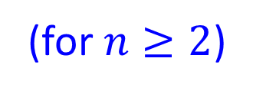
Linear Dependent
=
Vector Set 中有人耍廢
Given a vector set, {a₁, a₂, …, a_{n}}, there exists scalars x₁, x₂, …, x_{n}, that are not all zero, such that x₁a₁ + x₂a₂ + ☹ + x_{n}a_{n} = 0.
(for $n≥2$)
a_{i} 在耍廢
Given a vector set, {a₁, a₂, …, a_{n}}, if there exists any a_{i} that is a linear combination of other vectors
Linear Independent
=
Vector Set 中沒有人耍廢
Notes:
How about the vector with only one element?

Slide 9

Summary
$$A:m×n$$
$$x∈R^{n}$$
$$b∈R^{m}$$
Is $b$ a linear combination of columns of $A$?
Is $b$ in the span of the columns of $A$?
NO
YES
No solution
The columns of $A$ are independent.
The columns of $A$ are dependent.
Rank A = n
Rank A < n
Nullity A = 0
Nullity A > 0
Unique solution
Infinite solution
Notes:
Check existence first
One or infinite soluiton

Slide 10
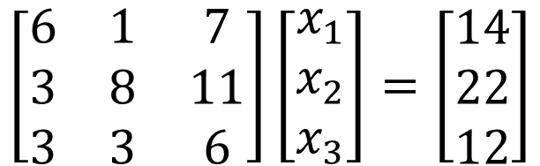


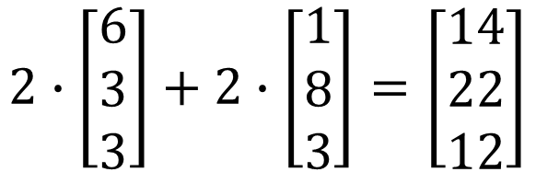
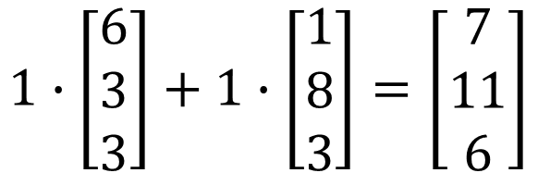
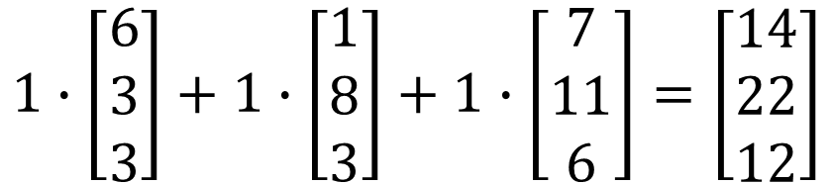
Intuition
Dependent:
Once we have solution, we have infinite.
Intuitive link between dependence and the number of solutions
dependent
$$\left[\begin{matrix}6 & 1 & 7 \\ 3 & 8 & 11 \\ 3 & 3 & 6\end{matrix}\right]\left[\begin{matrix}x_{1} \\ x_{2} \\ x_{3}\end{matrix}\right]=\left[\begin{matrix}14 \\ 22 \\ 12\end{matrix}\right]$$
$$1∙\left[\begin{matrix}6 \\ 3 \\ 3\end{matrix}\right]+1∙\left[\begin{matrix}1 \\ 8 \\ 3\end{matrix}\right]=\left[\begin{matrix}7 \\ 11 \\ 6\end{matrix}\right]$$
$$1∙\left[\begin{matrix}6 \\ 3 \\ 3\end{matrix}\right]+1∙\left[\begin{matrix}1 \\ 8 \\ 3\end{matrix}\right]+1∙\left[\begin{matrix}7 \\ 11 \\ 6\end{matrix}\right]=\left[\begin{matrix}14 \\ 22 \\ 12\end{matrix}\right]$$
$$\left[\begin{matrix}x_{1} \\ x_{2} \\ x_{3}\end{matrix}\right]=\left[\begin{matrix}1 \\ 1 \\ 1\end{matrix}\right]$$
$$2∙\left[\begin{matrix}6 \\ 3 \\ 3\end{matrix}\right]+2∙\left[\begin{matrix}1 \\ 8 \\ 3\end{matrix}\right]=\left[\begin{matrix}14 \\ 22 \\ 12\end{matrix}\right]$$
$$\left[\begin{matrix}x_{1} \\ x_{2} \\ x_{3}\end{matrix}\right]=\left[\begin{matrix}2 \\ 2 \\ 0\end{matrix}\right]$$
Infinite Solution

Slide 11
Proof
Columns of A are dependent → If Ax=b have solution, it will have Infinite solutions
If Ax=b have Infinite solutions → Columns of A are dependent

Slide 12



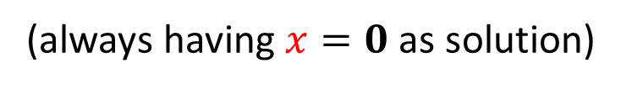

Proof
Homogeneous linear equations
$$Ax=0$$
(always having $x=0$ as solution)
Columns of A are dependent → If Ax=0 have solution, it will have Infinite solutions
If Ax=0 have Infinite solutions → Columns of A are dependent
$$A=\left[\begin{matrix}\begin{matrix}a_{1} & a_{2}\end{matrix} & \begin{matrix}⋯ & a_{n}\end{matrix}\end{matrix}\right]$$
dependent set
$$Ax=0⇒x_{1}a_{1}+x_{2}a_{2}+⋯+x_{n}a_{n}=0$$
there exist scalars $x_{1},x_{2},⋯,x_{n}$, not all zero
$$Ax=0 \text{have} \text{non}\text{−}\text{zero} \text{solutions}$$
$x_{1},x_{2},⋯,x_{n}$,
not all zero
$$x_{1}a_{1}+x_{2}a_{2}+⋯+x_{n}a_{n}=0$$

Slide 13

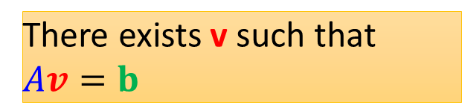

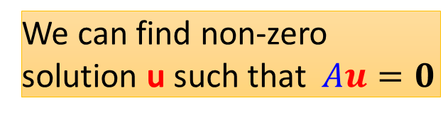

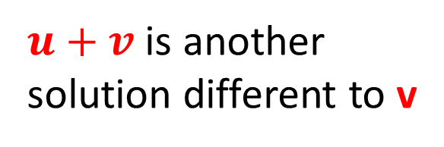


Proof
Ax=0 have infinite solutions
Columns of A are dependent → If Ax=b have solution, it will have Infinite solutions
If Ax=b have Infinite solutions → Columns of A are dependent
We can find non-zero solution u such that $Au=0$
$$A\left(u+v\right)=b$$
$u+v$ is another solution different to v
There exists v such that $Av=b$
Ax=0 have infinite solutions
$$Au=b$$
$$u≠v$$
$$A\left(u−v\right)=0$$
$$Av=b$$
Non-zero

